Slide 1

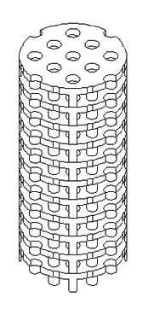
On 3D printing PPF for bone tissue engineering.

Slide 2
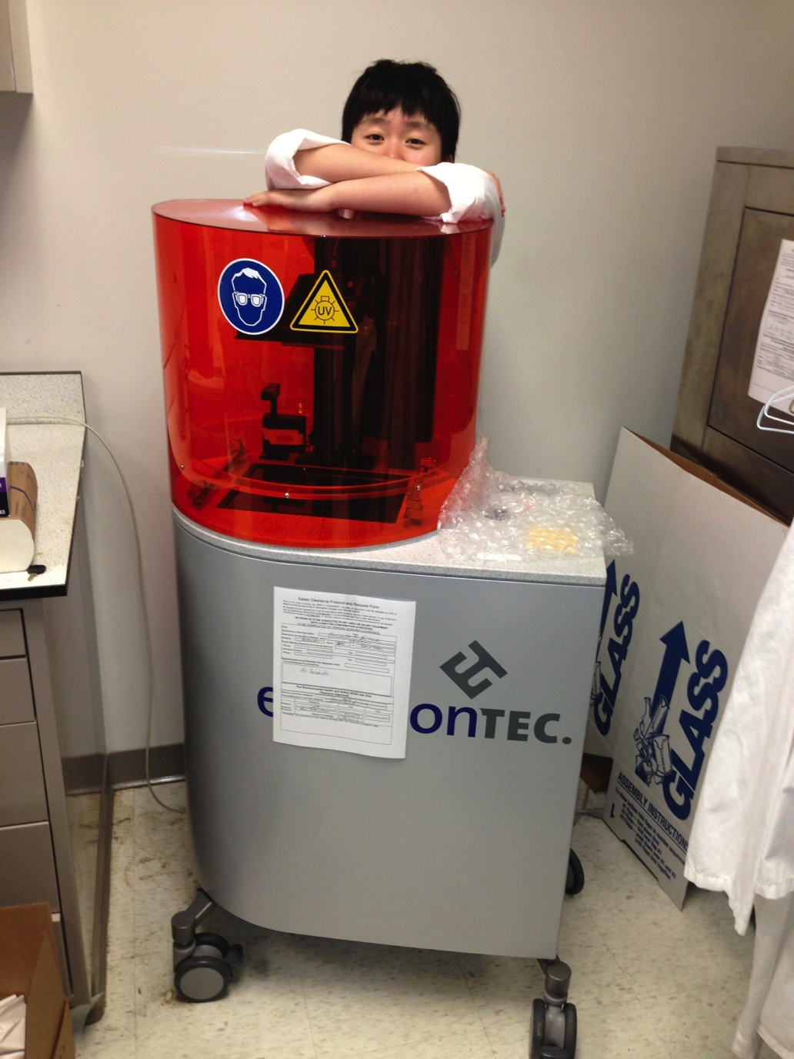
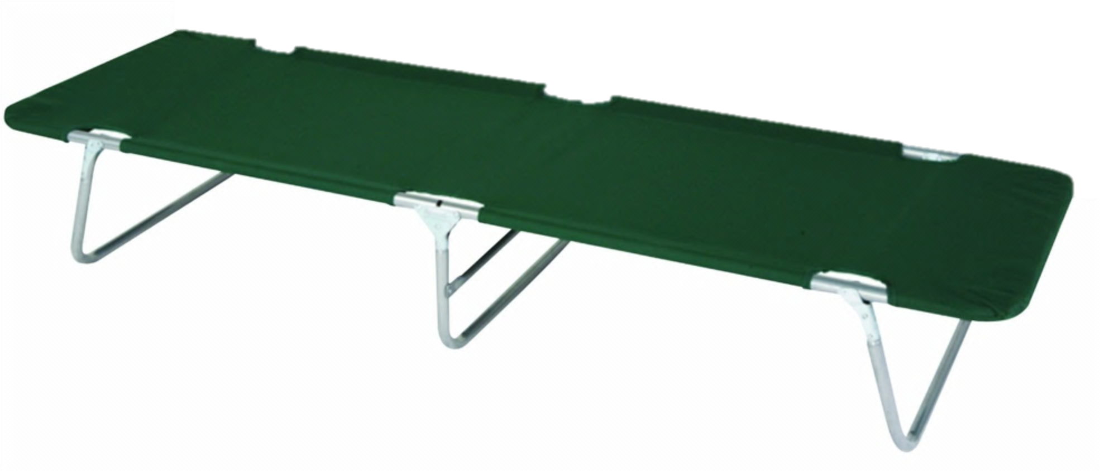

Slide 3
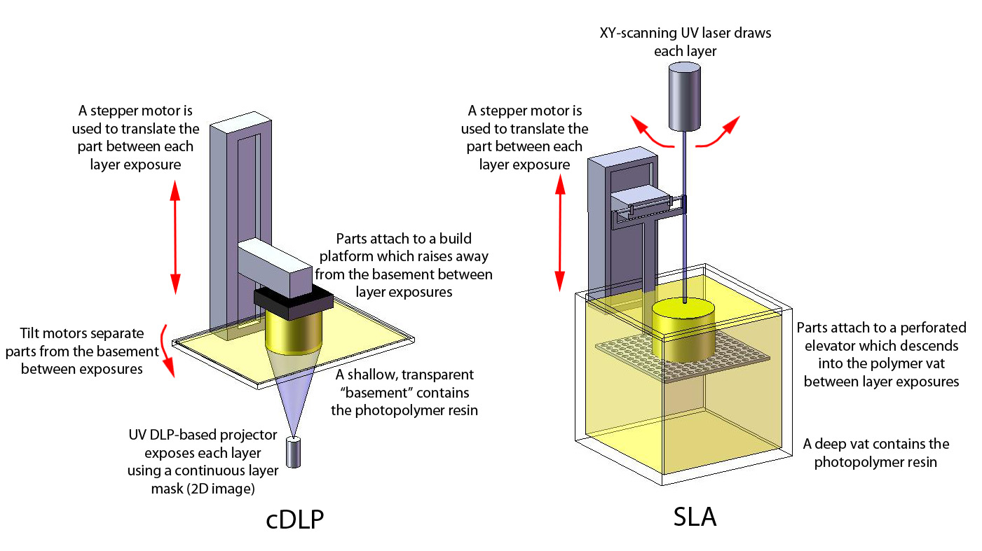

Slide 4
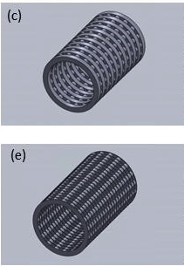
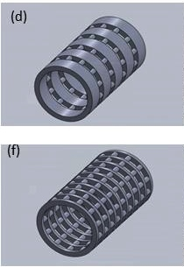

Slide 5
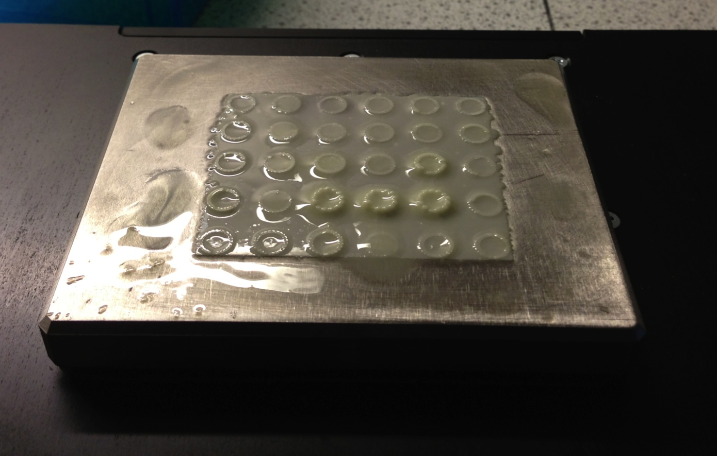

Slide 6
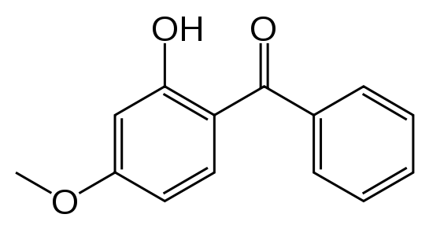
oxybenzone
Layer-thickness (z-resolution)
z
Over 33% needed as opposed to 3%-4% TiO₂ to achieve same layer thickness.

Slide 7
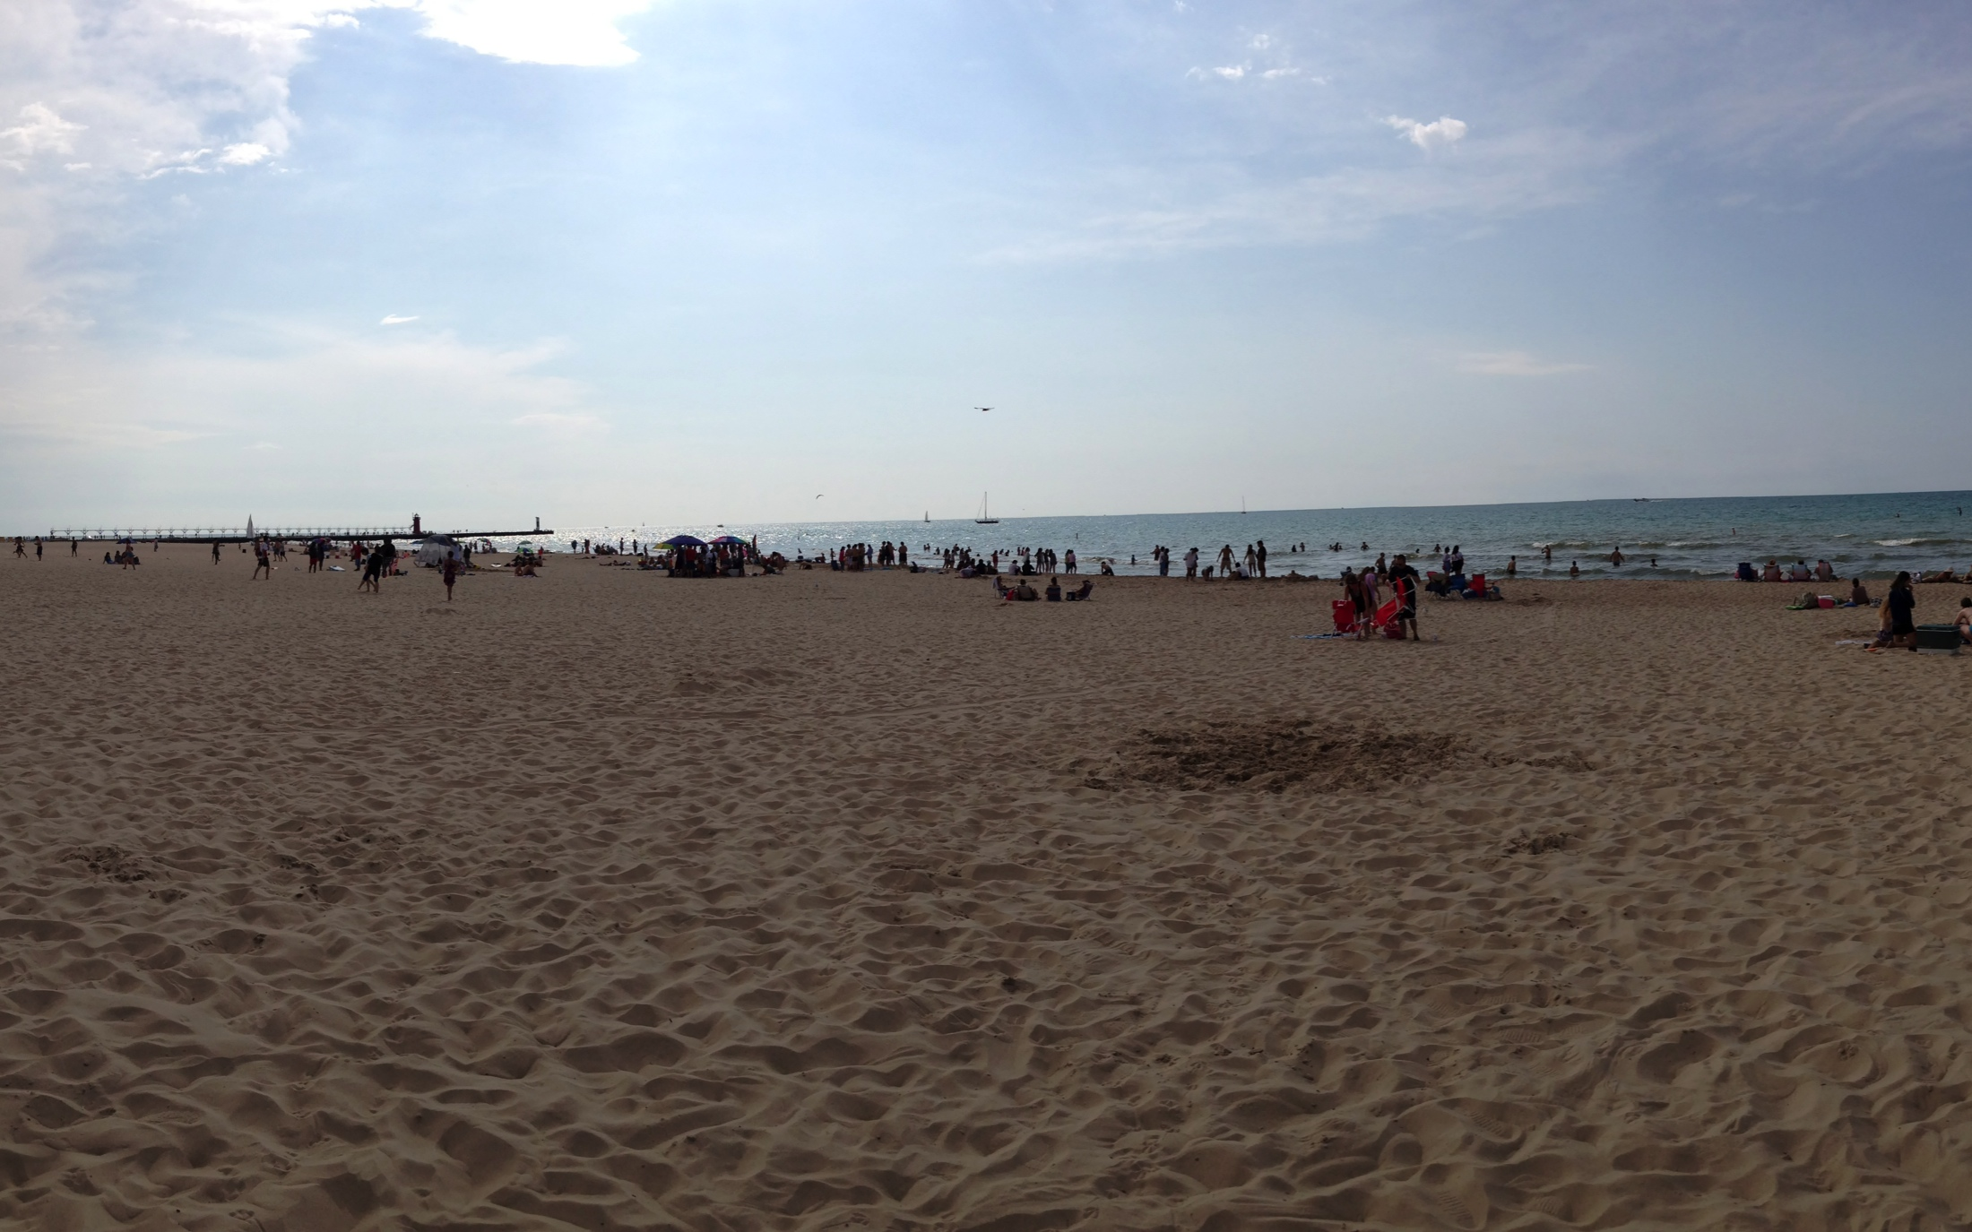

Slide 8
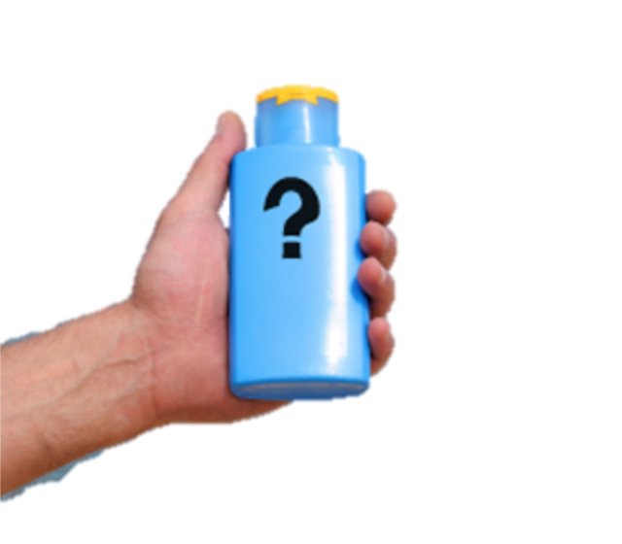
SPF
SUNSCREEN

Slide 9
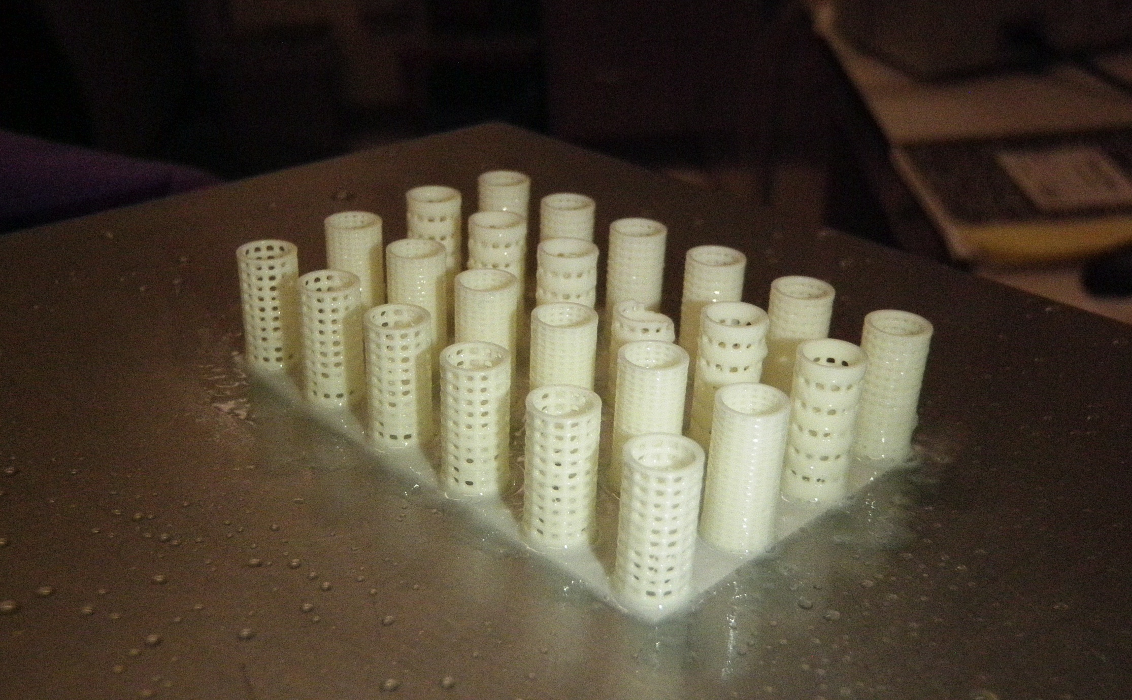

Slide 11
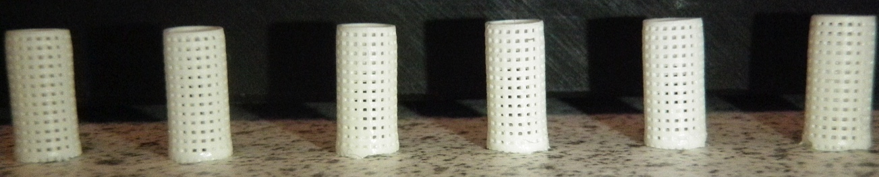
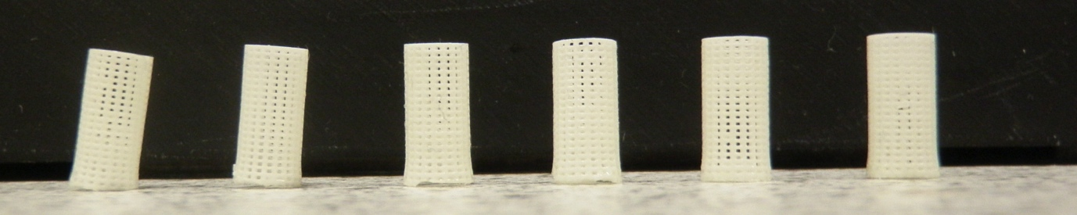
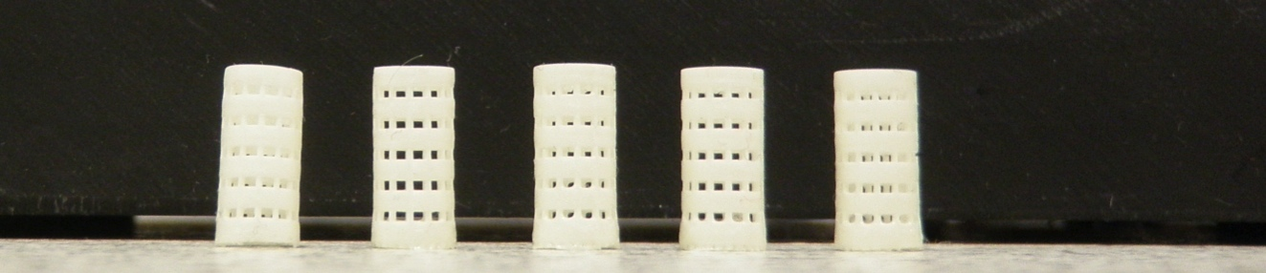
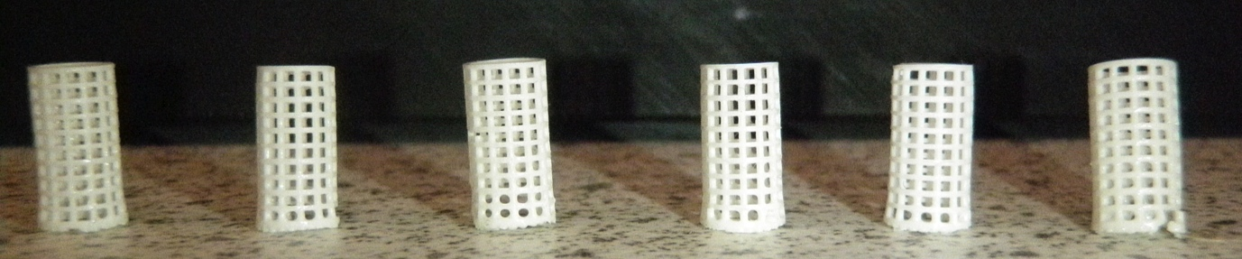

Slide 12
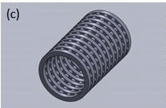
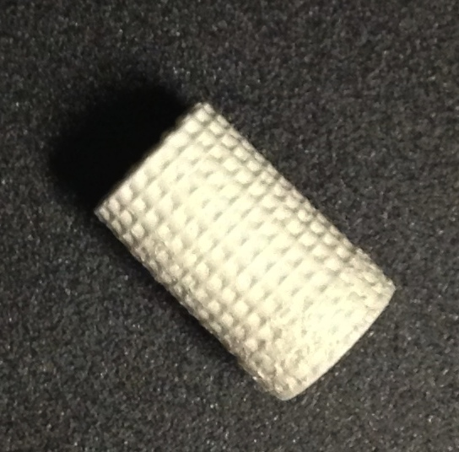
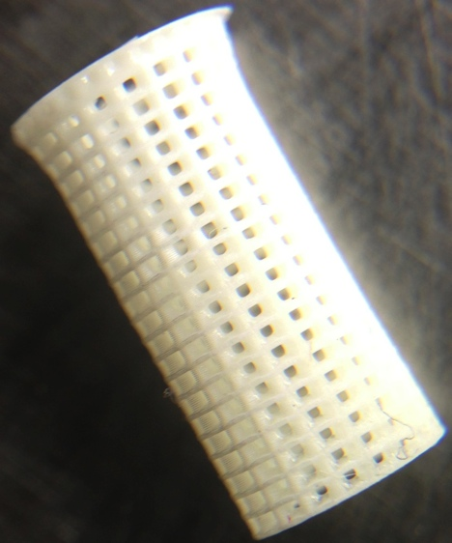
Increase in Resolution
No open pores
All open pores
Just TiO₂
TiO₂ and Oxybenzone

Slide 13
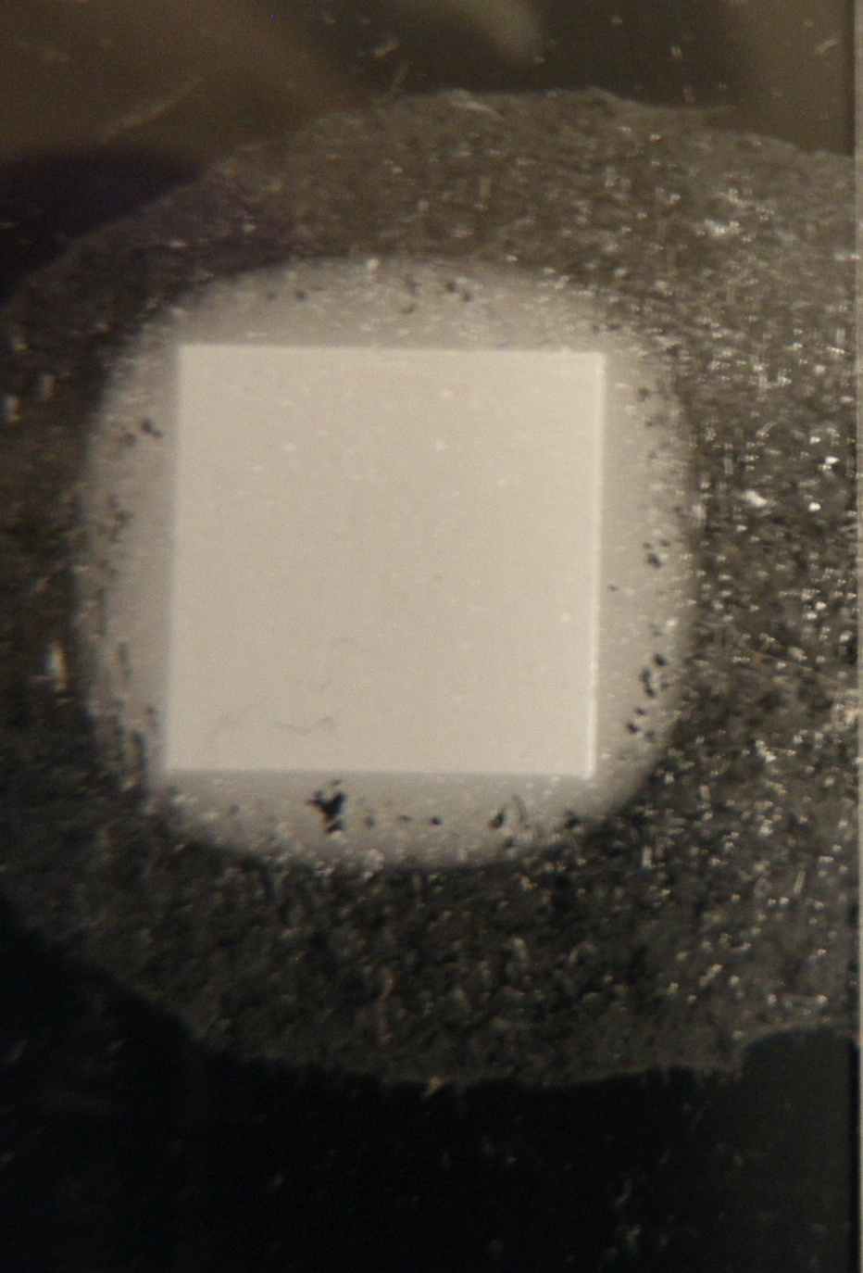
“dark cure”
TiO₂ alone

Slide 14
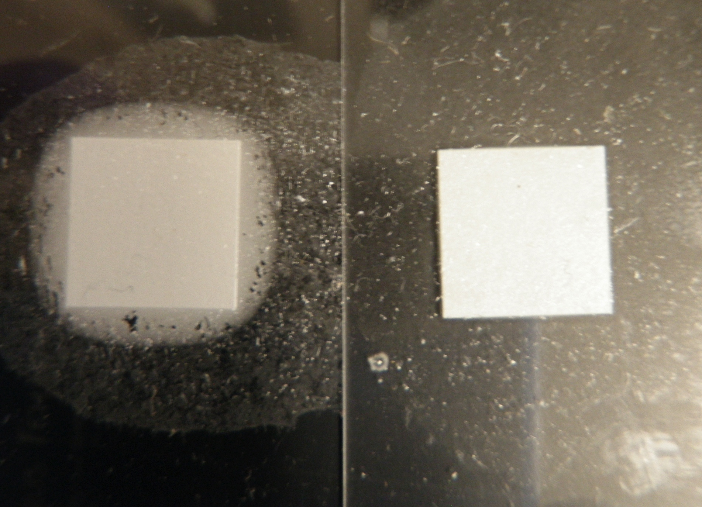
“dark cure”
No “dark cure”
TiO₂ alone
TiO₂ + Oxybenzone

Slide 15
The Magic Potion
1:1 PPF:DEF
1% Irgacure 819
1% TiO₂
28% Oxybenzone
With respect to mass of PPF & DEF
PPF Parameters:
M_{n}: 866 da
PDI: 1.3

Slide 16
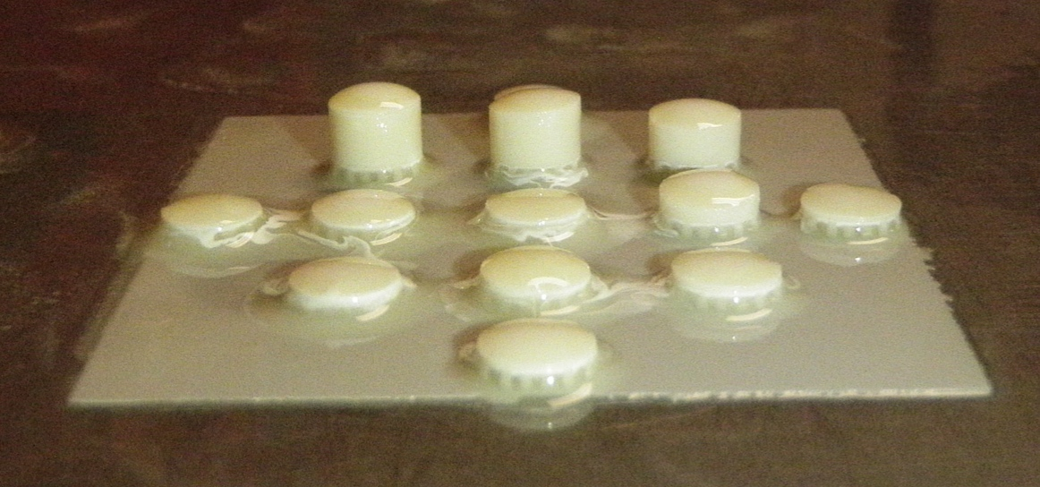

Slide 17
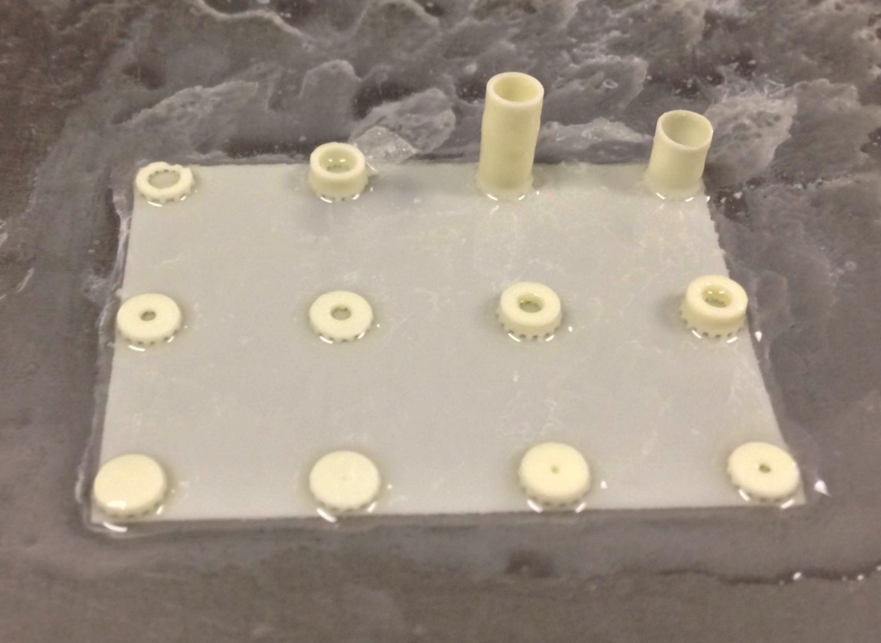

Slide 18
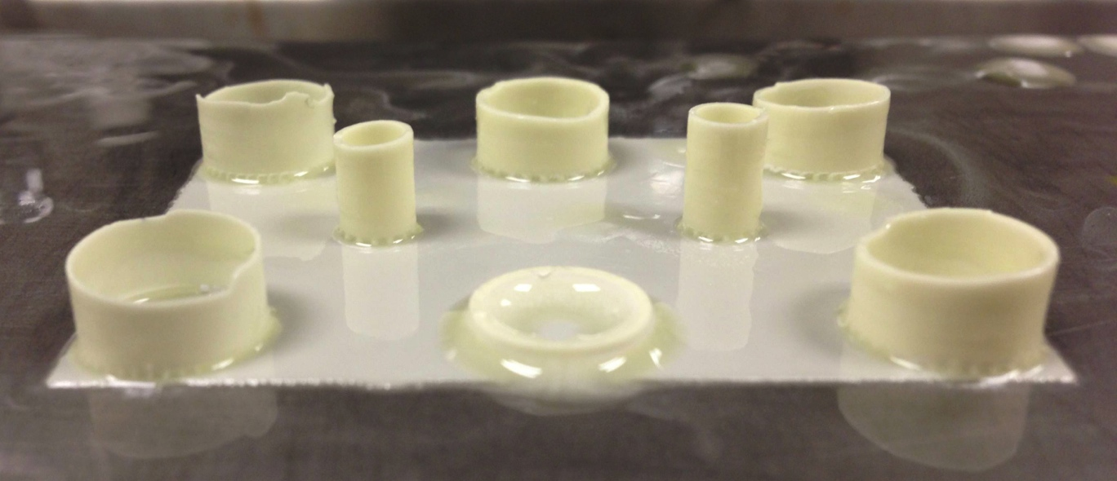

Slide 19
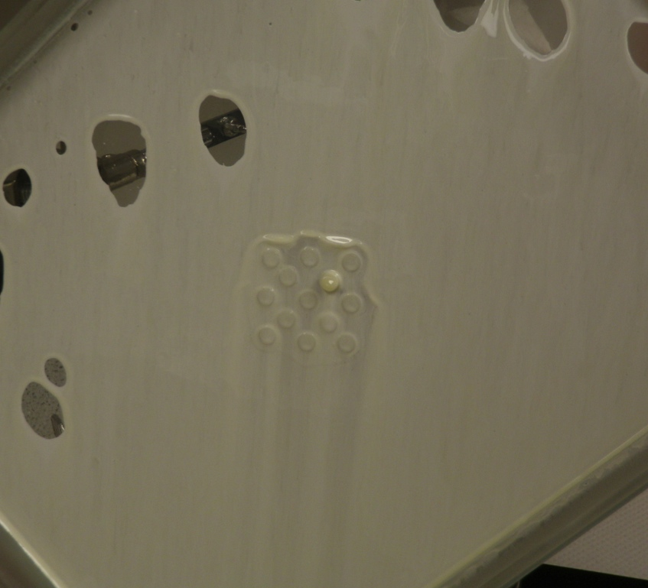

Slide 20


Slide 21
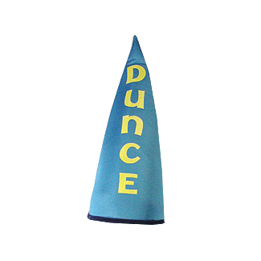
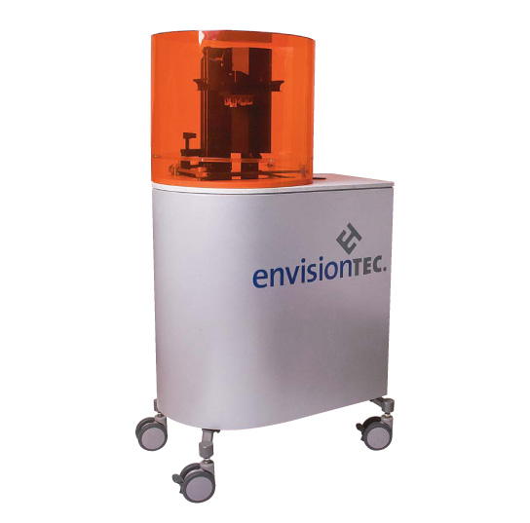

Slide 22
Time Out!!
Potential Fixes:
Increase the light intensity
Tighten up the bandwidth

Slide 23

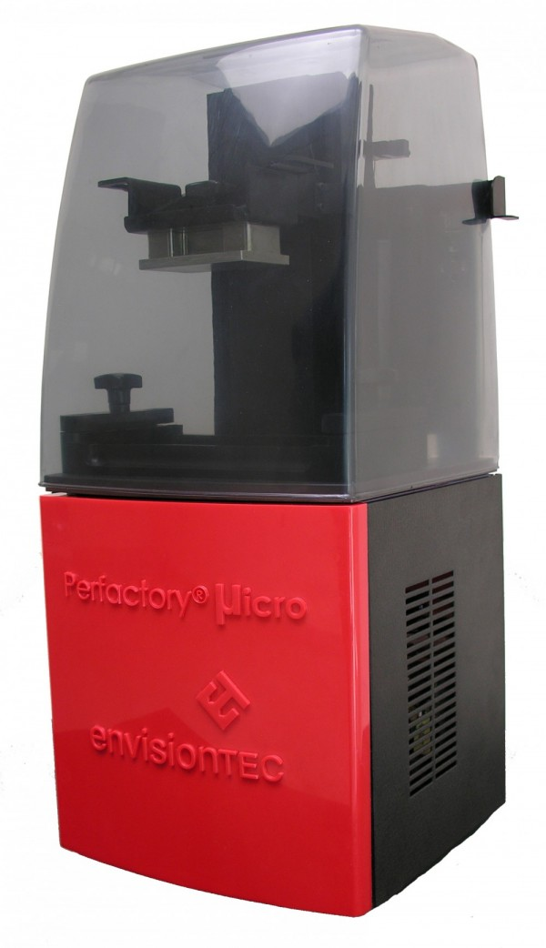
The Perfactory Micro^{beta}
Key Benefits:
Micro
P3
Lamp warm up time:
Calibration required:
Calibration time:
User control of build-style:
Control of Job-file:
Resin required:
GUI via computer:
0 min
None
0 min
Full
Full
40 ml
Yes
30 min
Yes
Up to 2 hours
Very limited
Limited
200 ml
No
80% less material required to run it!

Slide 25
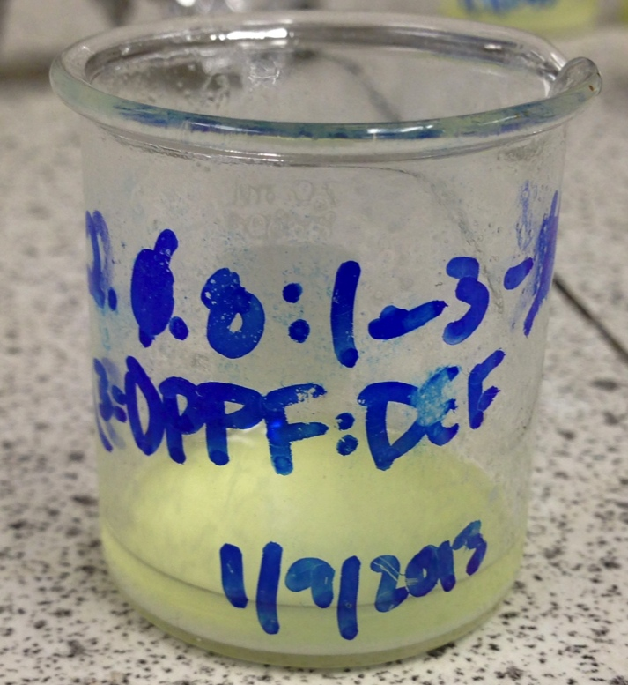

Slide 26
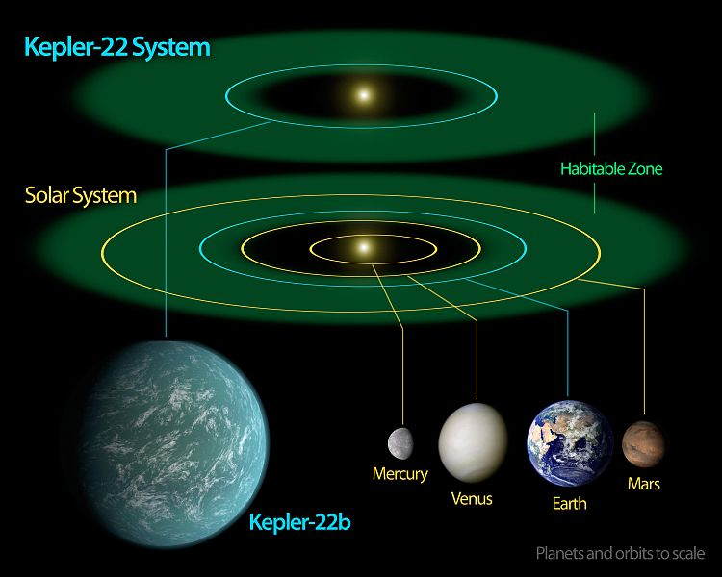

Slide 27
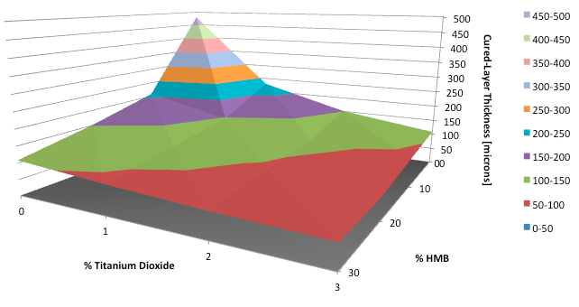
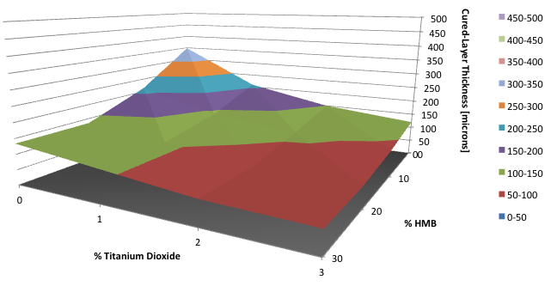
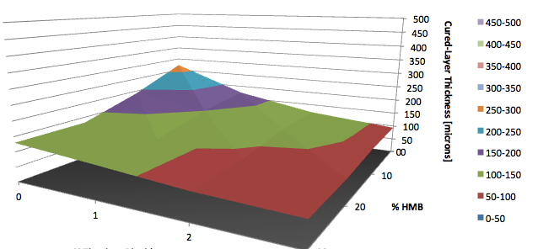
1% Irgacure 819
2% Irgacure 819
3% Irgacure 819
You are here
“The Goldilocks zone.”

Slide 28
Material Variables:
Polymer kind
Polymer concentration
Polymer molecular weight [da]
Polymer polydispersity [unit-less]
Diluent/Solvent kind
Diluent/Solvent concentration
Photoinitiator kinds
Photoinitiator concentrations
Dyes (kinds and concentrations)
Pigments (kinds and concentrations)
Origin date
Printer Variables:
Light intensity [mW/dm²]
Light wavelengths [nm]
Burn-in range [μm]
Burn-in range exposure time [s]
Standard range [μm]
Standard range exposure time [s]
z-step size [μm]
Base plate height [μm]
Peel velocity [μm/s]
Separation velocity [μm/s]
Residence time before exposure [s]
Residence time after exposure [s]
Basement type [material]
Post Processing Variables:
Post cure time
Wash method

Slide 29
Material Variables:
Polymer kind
Polymer concentration
Polymer molecular weight [da]
Polymer polydispersity [unit-less]
Diluent/Solvent kind
Diluent/Solvent concentration
Photoinitiator kinds
Photoinitiator concentrations
Dyes (kinds and concentrations)
Pigments (kinds and concentrations)
Origin date
Printer Variables:
Light intensity [mW/dm²]
Light wavelengths [nm]
Burn-in range [μm]
Burn-in range exposure time [s]
Standard range [μm]
Standard range exposure time [s]
z-step size [μm]
Base plate height [μm]
Peel velocity [μm/s]
Separation velocity [μm/s]
Residence time before exposure [s]
Residence time after exposure [s]
Basement type [material]
Post Processing Variables:
Post cure time
Wash method

Slide 30
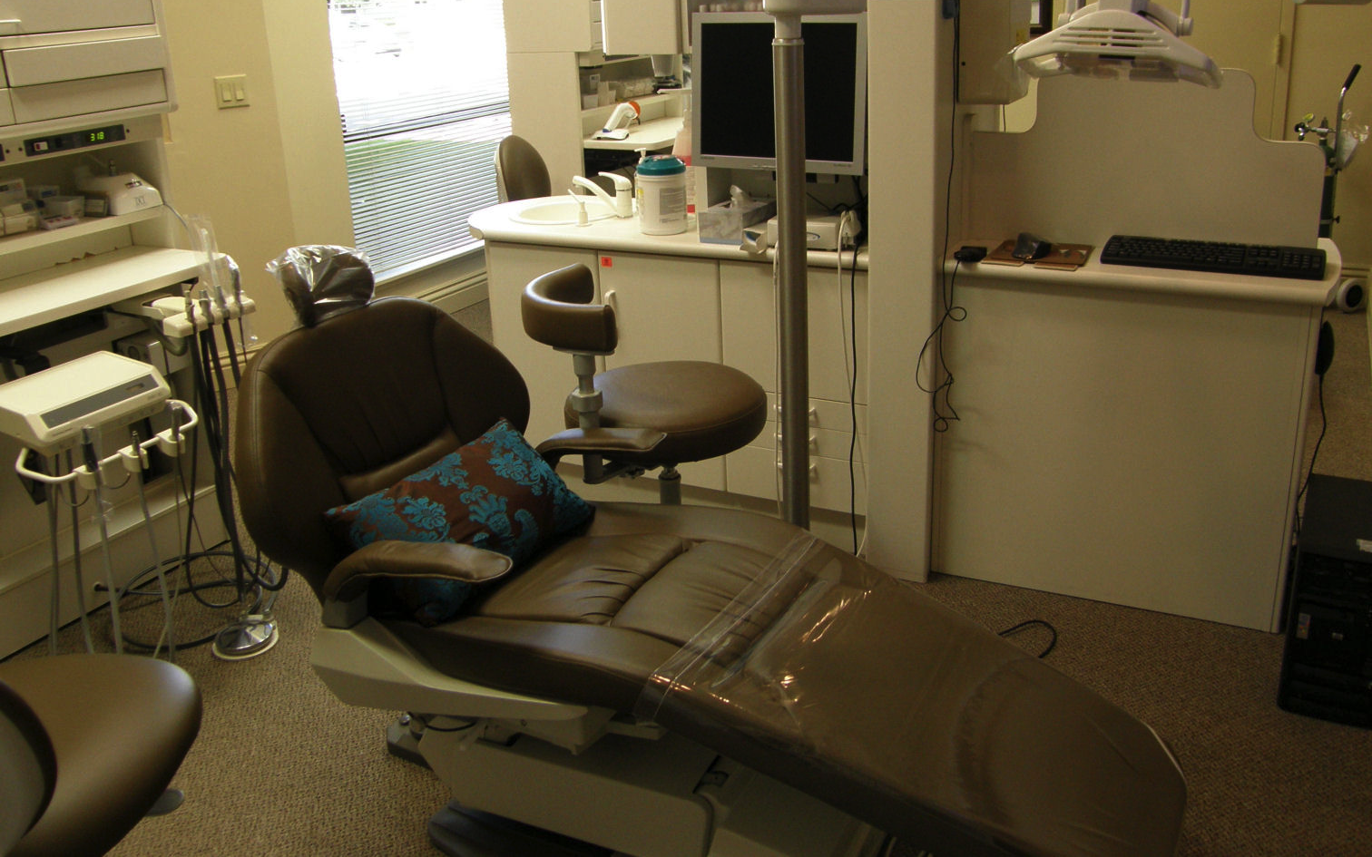

Slide 31
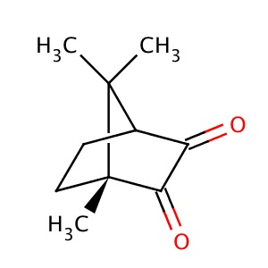
Camphorquinone

Slide 32
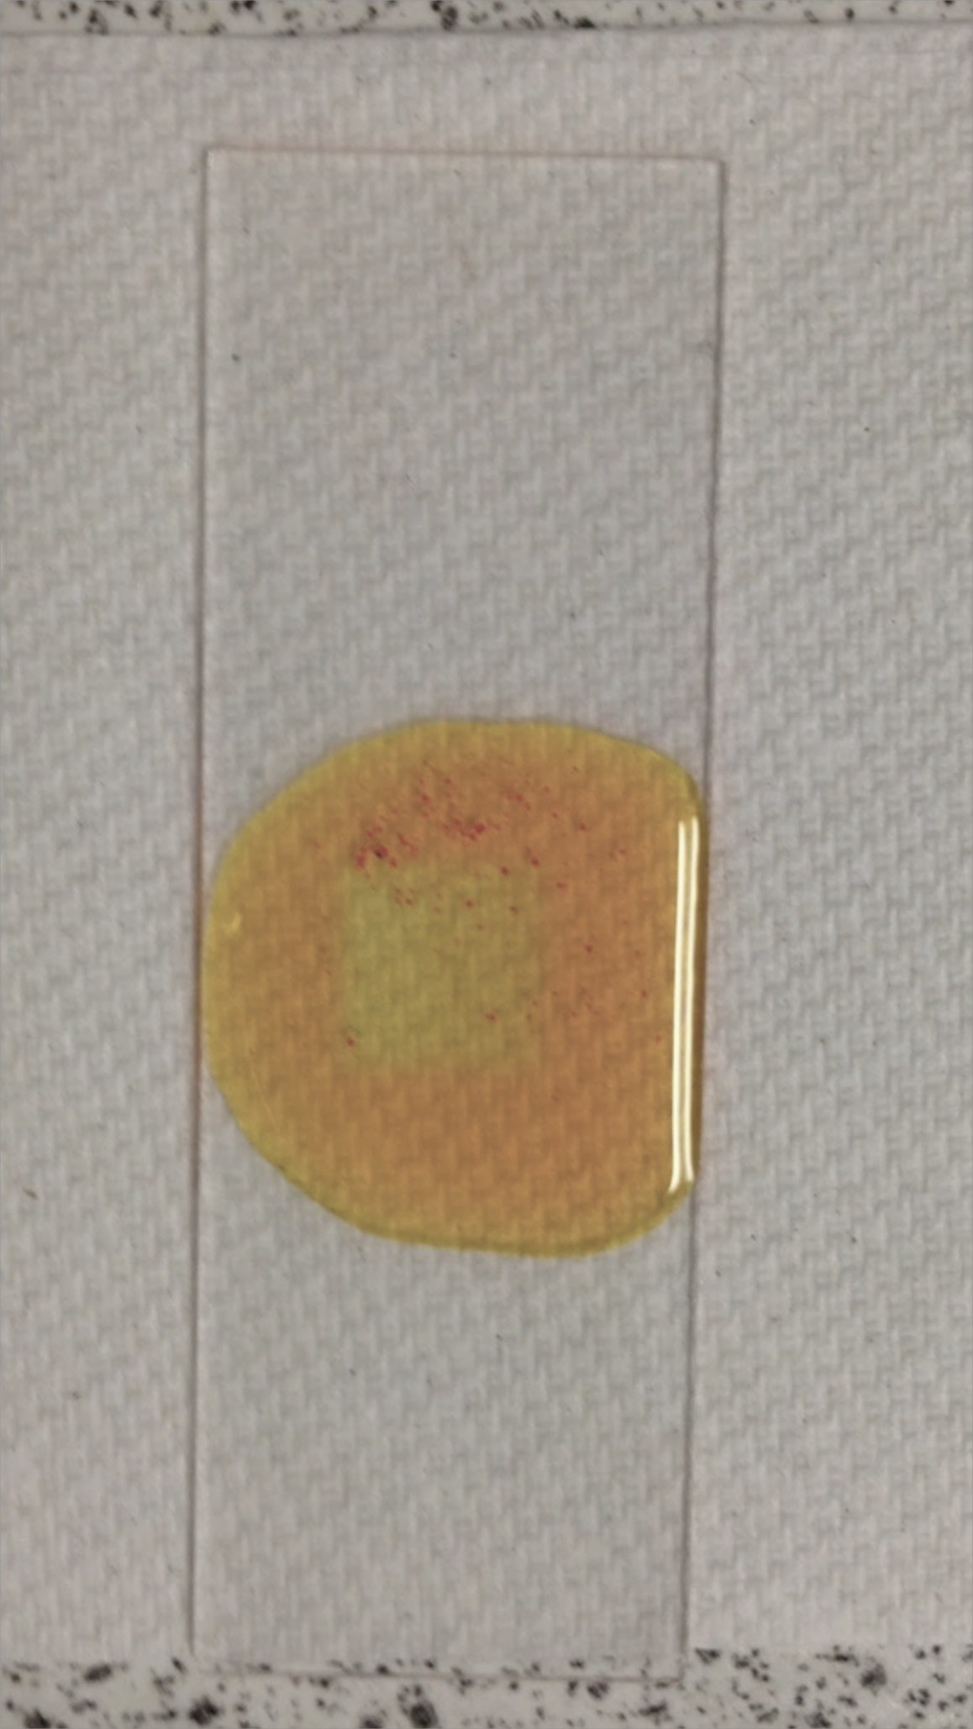
Camphorquinone
Result: A polymer puddle

Slide 33

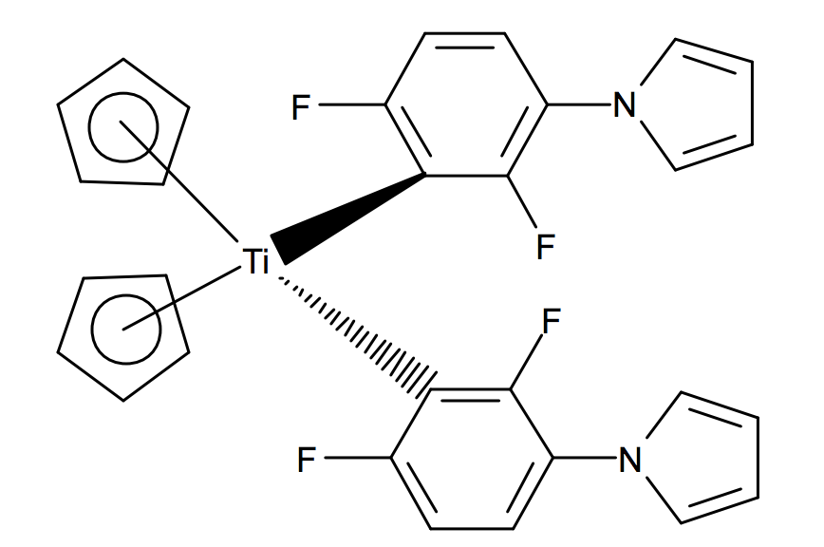
Irgacure 784
A NEW HOPE
Biocompatible¹
Favorable absorption profile²
Zhang. Et al. (2011). Development of Photocrosslinkable Urethane-Doped Polyester Elastomers for Soft Tissue Engineering
Ciba Specialty Chemicals Inc. Edition: 2.4.98, Basle

Slide 34
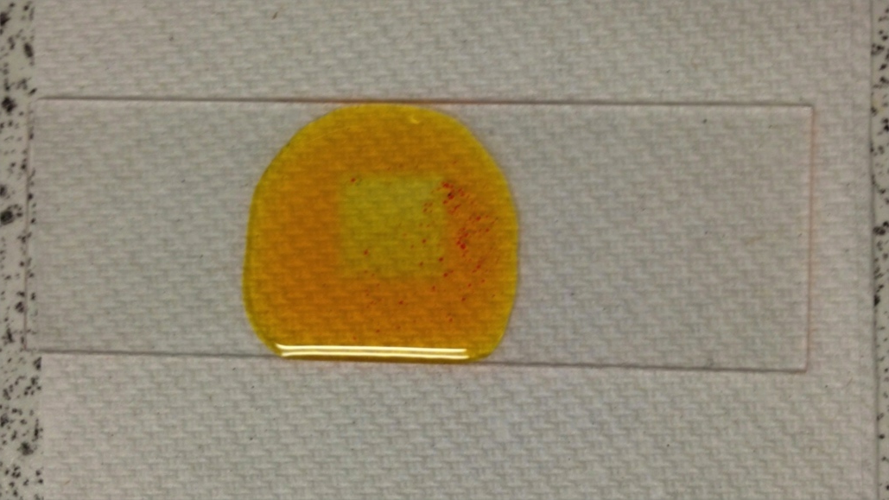
Irgacure 784
Result: A polymer puddle

Slide 35
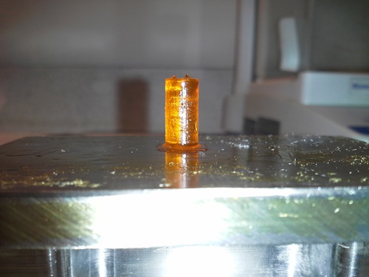
6 mm x 12 mm Solid Cylinder (1.5:1 PPF:DEF, 3% BAPO, 3% 784)
Build Parameters:
Printer: Micro
Intensity: 267 mW/dm2
Exposure time: 120 s
z-step: 50 μm

Slide 36
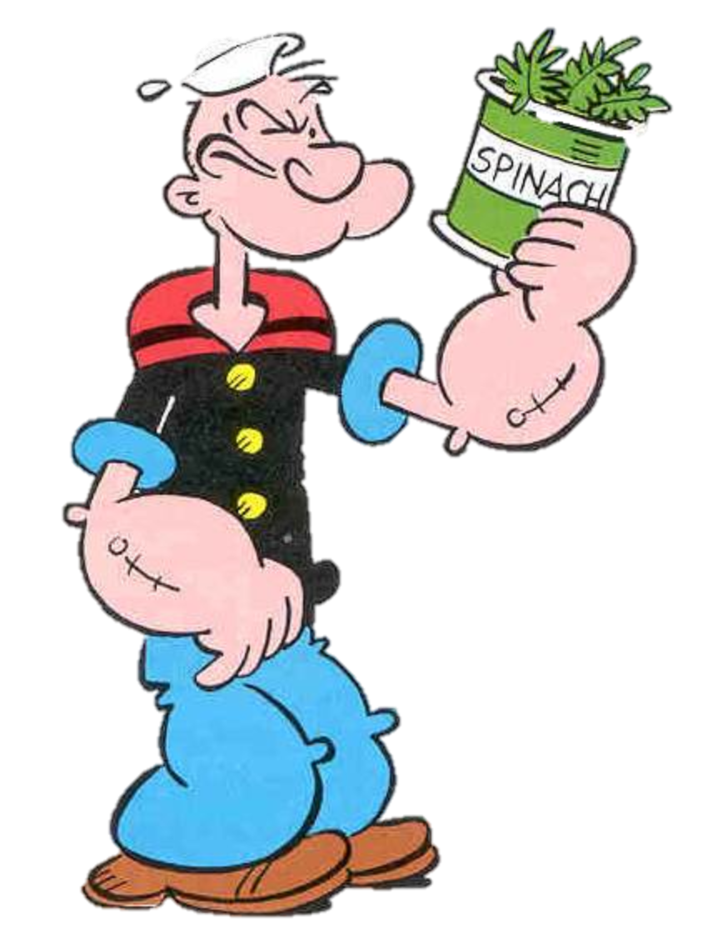
Almost 1.0 GPa!!
Previous studies showed maximum PPF modulus as: 195.3 +/- 17.5 MPa.

Slide 37
Avg. Modulus: 334 MPa

Slide 38
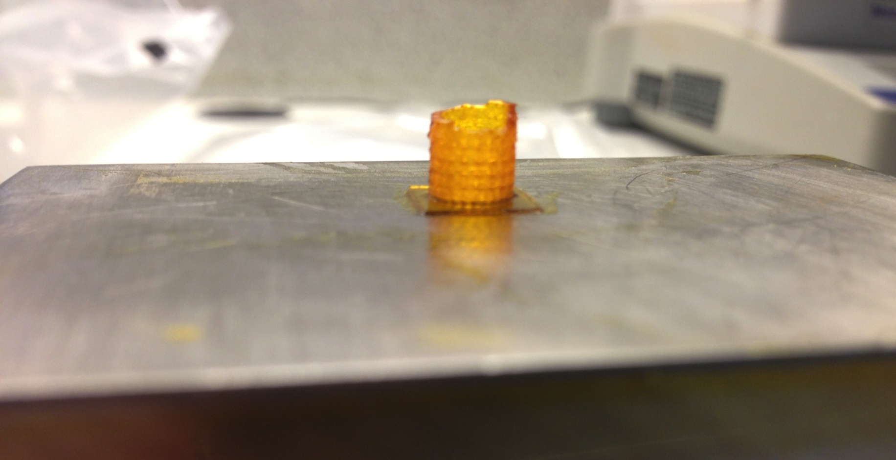

Slide 40
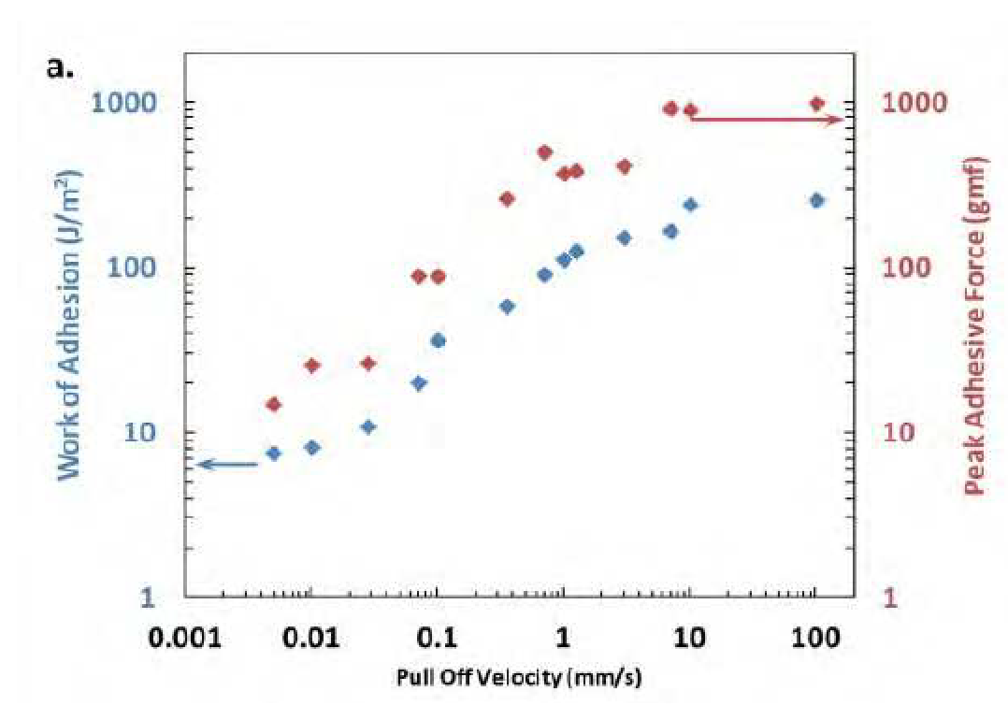
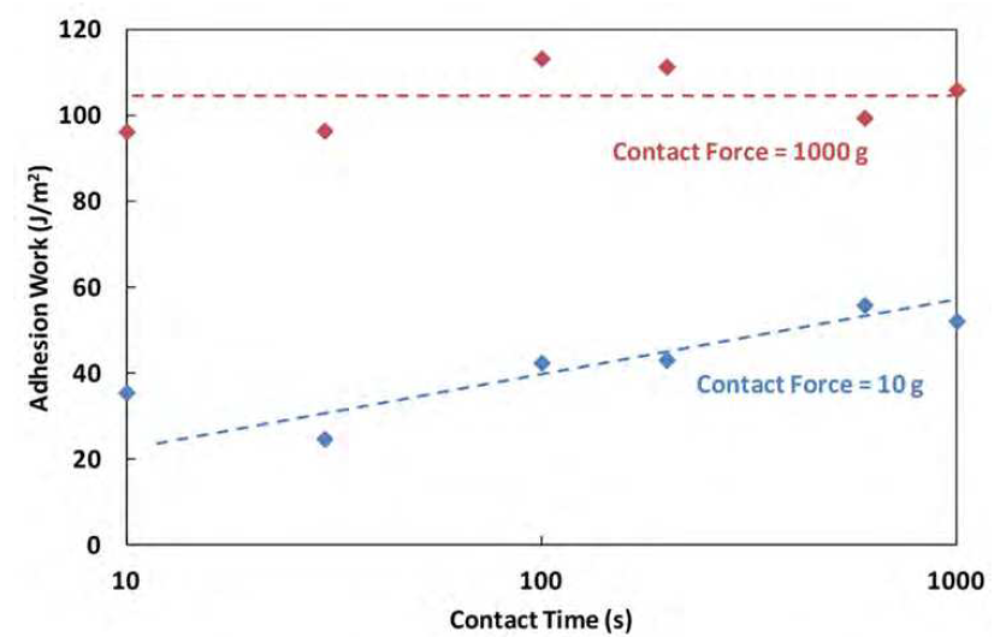
Hypothesis:
Adhesion to the basement is a serious factor.
Shear forces due to PSA basement during build may be resulting in failure at extended time points.
What we know about adhesion:
Grillet et al. (2012). Polymer Gel Rheology and Adhesion.

Slide 41

The answer!
Return of the Perfactory
Benefits:
Higher intensity than Micro
Peel mechanism
PSA not required

Slide 42
Resin:
Name: BY
1:1 PPF:DEF
M_{n}: 933 da
Polydispersity: 1.9
3% Irgacure 819
0.5% Irgacure 784
The build
Build parameters:
Printer: Perfactory P3
Intensity: 350 mW/dm²
Exposure time: 30 s
Slow peel

Slide 43
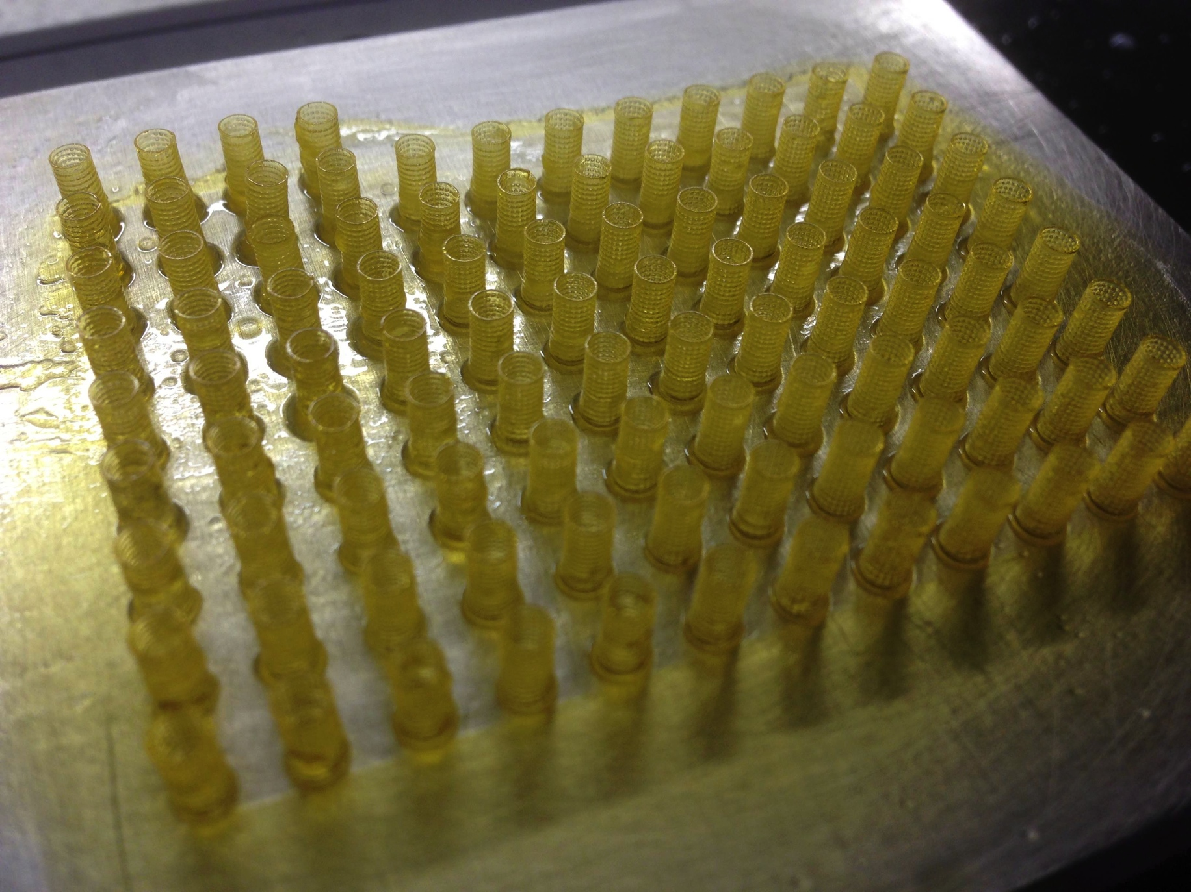

Slide 44
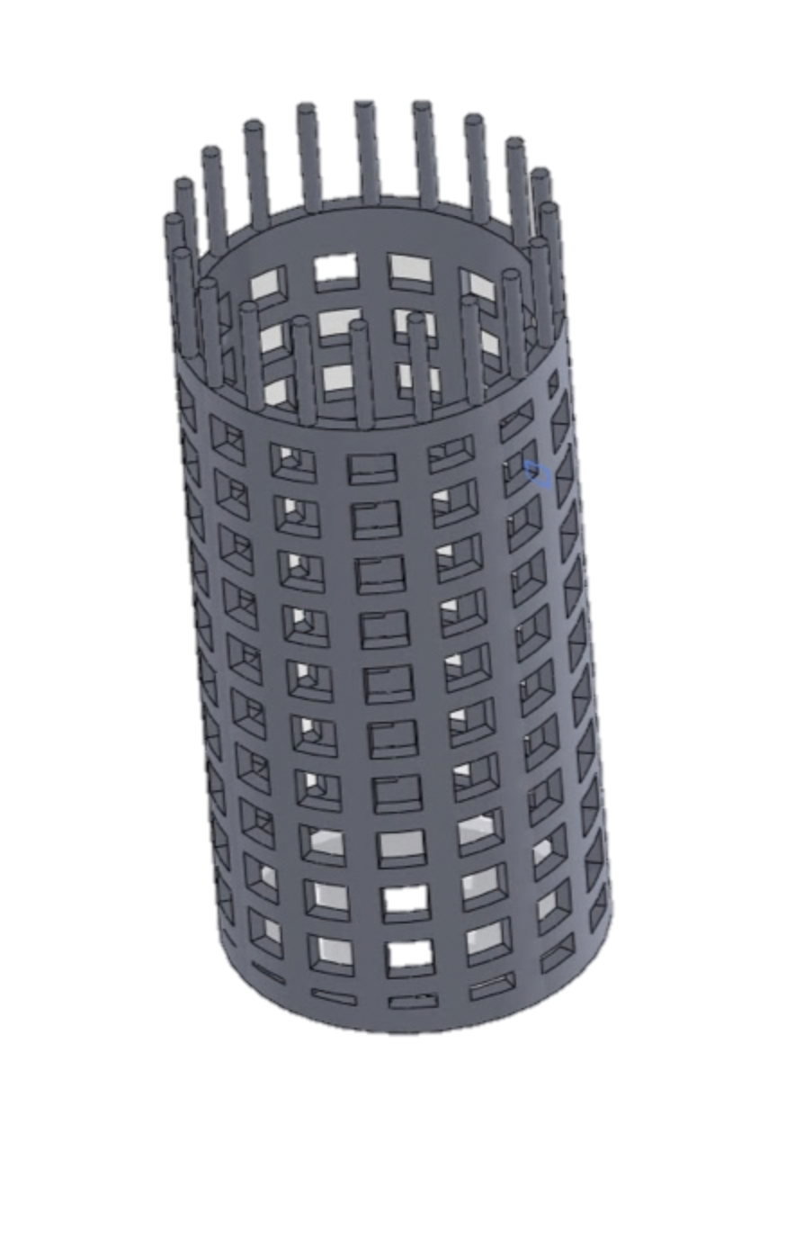
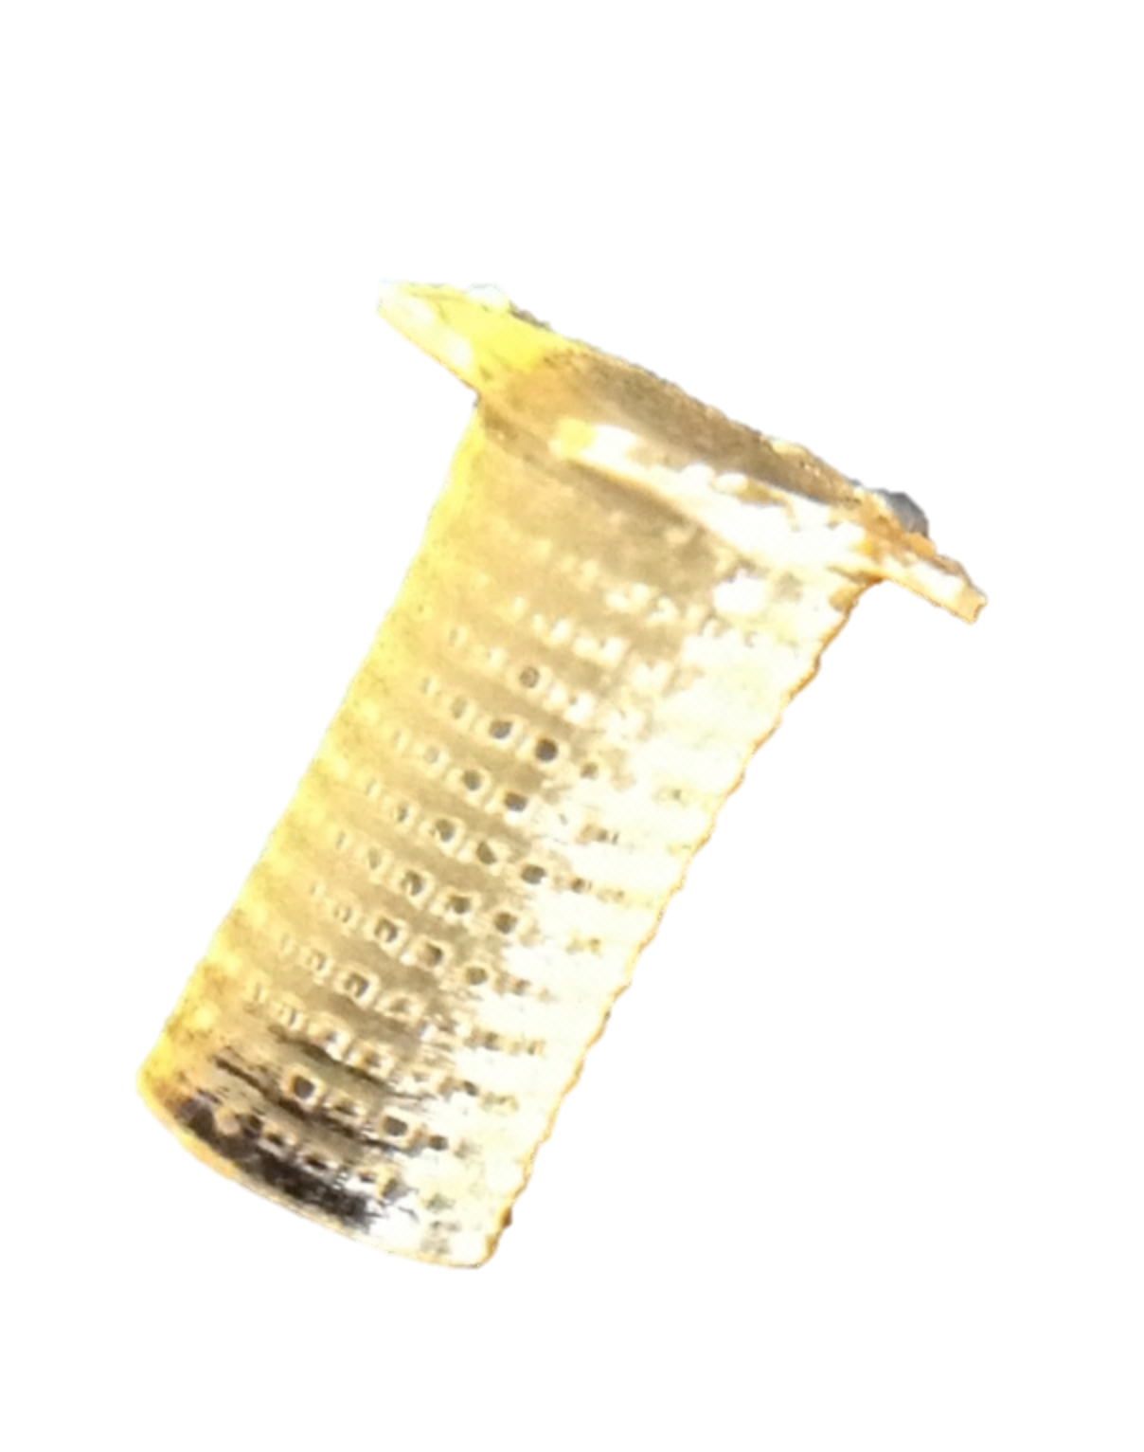
Compression Testing
Compression Test Parameters:
Instron
Load Cell: 100 lb_{f} (444 N)
Strain Rate: 0.1 mm/s
Max Strain: 2 mm
~ 2.75 mm
~ 6 mm
Nominal Part parameters:
Height: 6 mm
Outer diameter: 2.75 mm
Wall thickness: 125 μm
Pore size: 350 μm

Slide 46
Resin:
1:1 PPF:DEF
3% Irgacure 819
0.5% Irgacure 784
Post Cure Time: 480 min
Error bars: +/- 1 std. dev
Result:
1800% increase in modulus with post-curing.

Slide 47
Resin:
1:1 PPF:DEF
3% Irgacure 819
0.5% Irgacure 784
Post Cure Time: 480 min
Error bars: +/- 1 std. dev
Result:
2200% increase in compressive strength with post-curing.

Slide 48
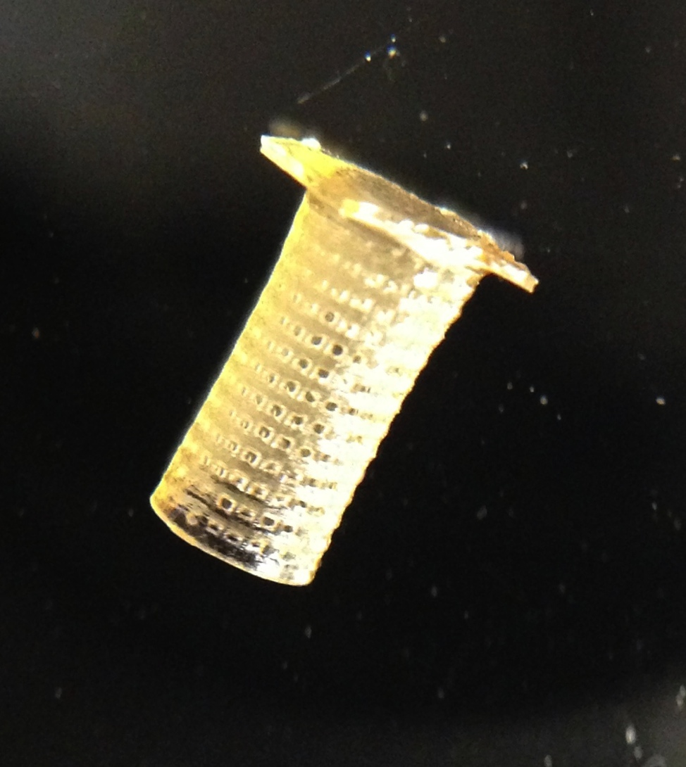
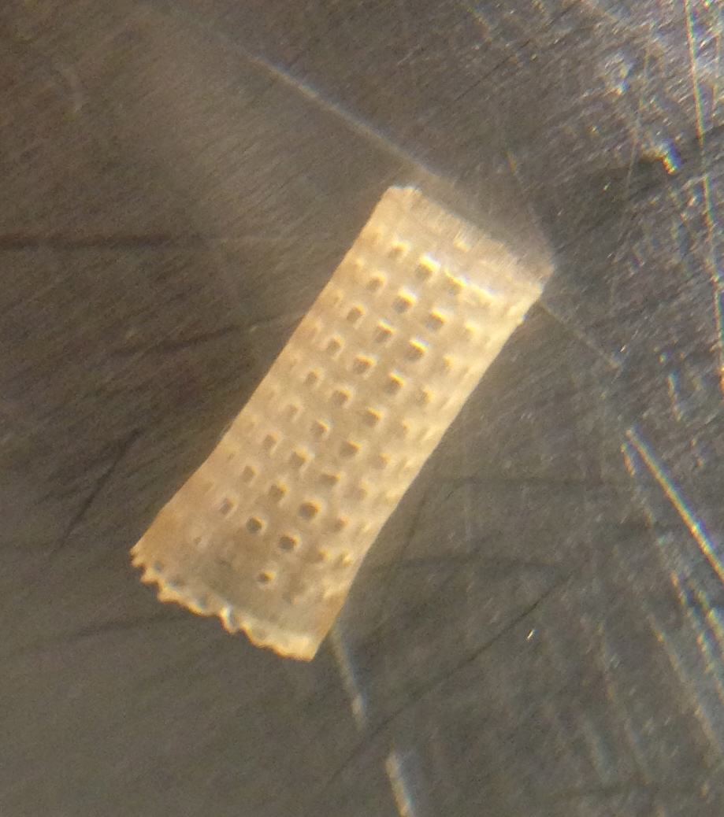
1:1 PPF:DEF, 3% Irgacure 819, 0.4% Irgacure 784, 0.3% Oxybenzone
1:1 PPF:DEF, 3% Irgacure 819, 0.5% Irgacure 784

Slide 49
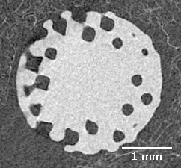
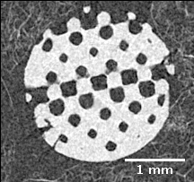
The Importance of Post Processing Techniques
core area pores are not cleared
core area pores are open
Post cured with no post-processing.
Post cured after post-processing (100% acetone over night).
Both of these are the same build with different post-processing handling.
Resin: BY-Full (1:1 PPF:DEF, 3% BAPO, 0.5% I784)
*Note these SEM images were captured with the scaffold not perfectly aligned.

Slide 50
Notes:
4x increase in resolution
70% reduction in build time
4x increase in strength
Ability to tune strength
Labor and stop free operation
Ability to print more geometries

Slide 51
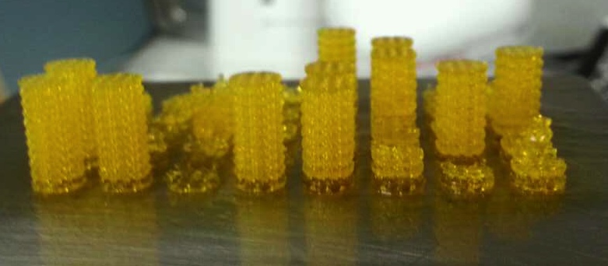

Slide 53










THANK YOU
{ The Team }
Notes:
Review
Having a robust and commercializable process is essential to bringing a treatment to clinic.
The many variables that can be controlled pose a daunting task to analyze and understand.
We have been able to develop a biodegradable resin that has:
High resolution,
Controllable mechanical properties,

